Slide 1
Computer Vision (CV)
Pose estimation
YOLOv8:12 and MediaPipe

Slide 2
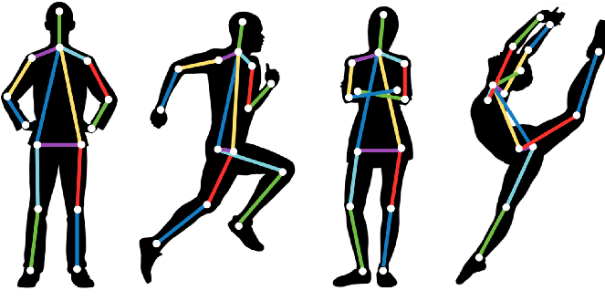
What is pose estimation
Predicting the location of the key body joints of a human
Also called pose detection or keypoint detection

Slide 3
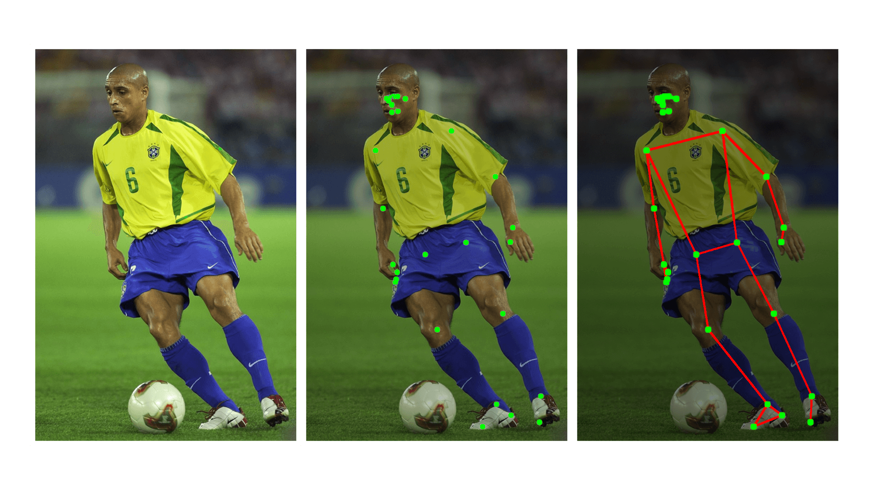
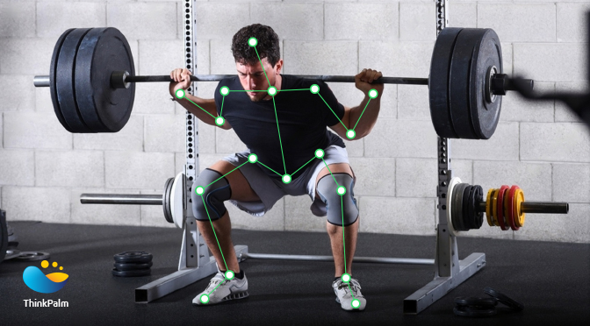
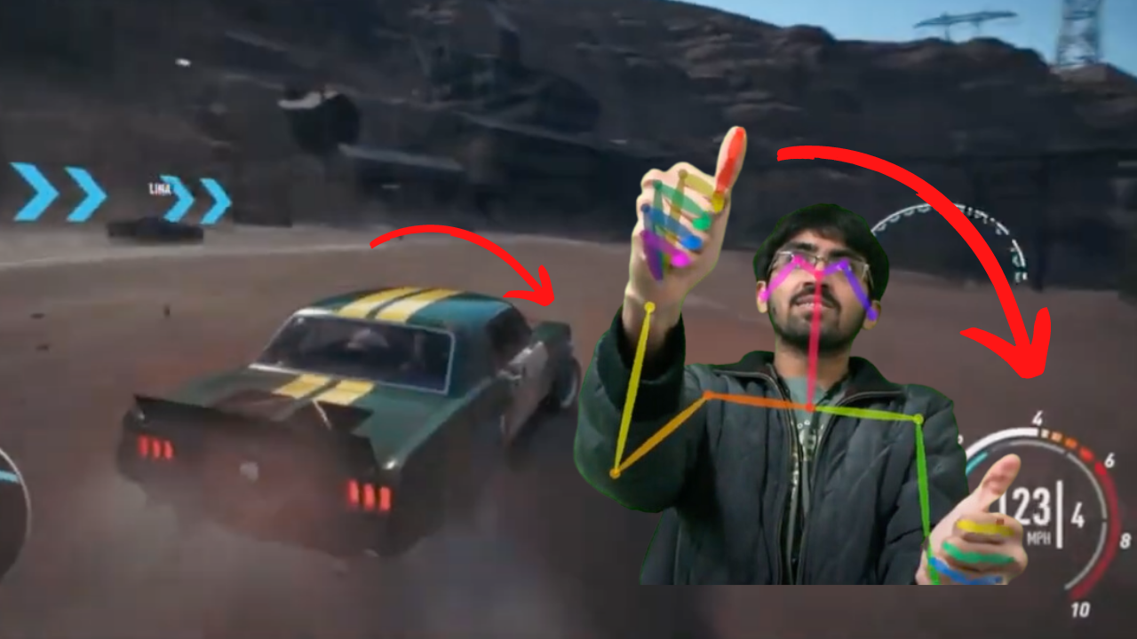
Why pose estimation
Many applications:
Human activity prediction
Sports analysis
Detecting accidents (Fall detection)
AI fitness app
AR and VR (personal avatars)
Motion capture (teaching robots, gaming, etc.)
Surveillance (crime detection)

Slide 4
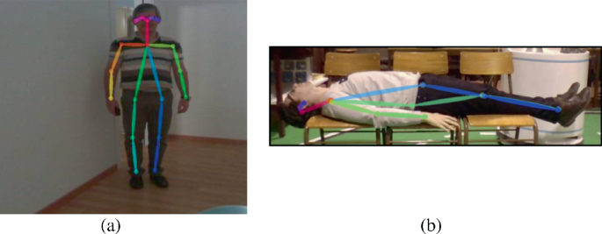
Pose estimation results as features
We can use the pose estimation coordinates as features to predict an action
For simple tasks, we can compare the coordinates using simple rules
For example, in fall detection
We can compare the vertical distance (head-foot) with some threshold

Slide 5



Pose estimation results as features
For complex tasks, we can create a dataset of coordinates
Then we train a machine learning model using that dataset
Simple models (frame-by-frame): Logistic regression, Decision tree, SVM, …
Or Sequence models: LSTM, 1D Conv
Running
Standing
Walking
Etc.
Imags/Video
Pose coordinates
Dataset
ML Model
Prediction

Slide 6
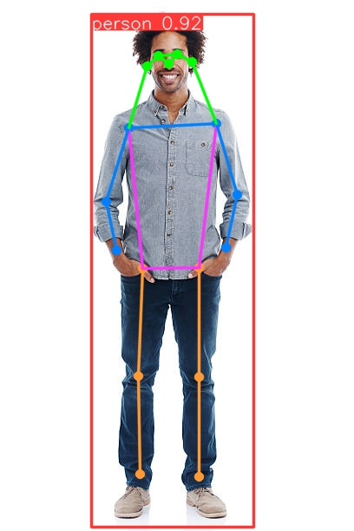
YOLOv8
Use "-pose" suffix in model's name
Example: yolov8n-pose.pt
The result will have an attribute for keypoints

Slide 7
YOLOv8
It detects 17 keypoints
Can detect multiple humans in the same image

Slide 8
YOLOv8:12
2
1
4
0
3
idx | part | idx | part
0 | Nose | 9 | Left wrist
1 | Left eye | 10 | Right wrist
2 | Right eye | 11 | Left hip
3 | Left ear | 12 | Right hip
4 | Right ear | 13 | Left knee
5 | Left shoulder | 14 | Right knee
6 | Right shoulder | 15 | Left ankle
7 | Left elbow | 16 | Right ankle
8 | Right elbow
6
5
7
8
12
11
10
9
14
13
16
15

Slide 9
Hand raised example
2
1
If the wrist is higher than the shoulder
For left hand, compare keypoints 9 and 5
For right hand, compare keypoints 10 and 6
We compare the y-coordinates
4
0
3
10
9
6
5
8
7
12
11
14
13
16
15

Slide 10

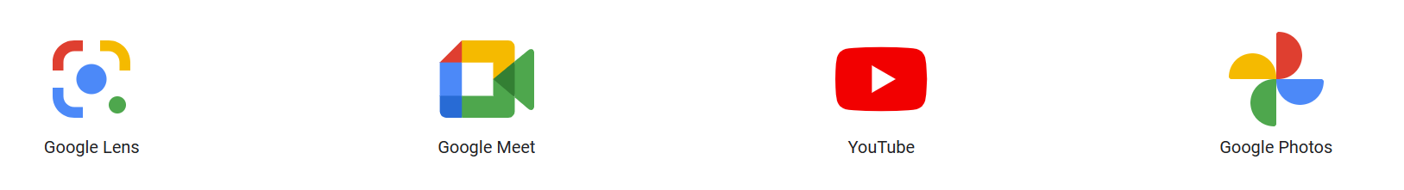
An open source, cross-platform, customizable ML solution for live and streaming media
Created by Google, and it powers the ML in many Google products
Provides solutions for
Computer vision
Natural language processing
Audio
Others

Slide 11
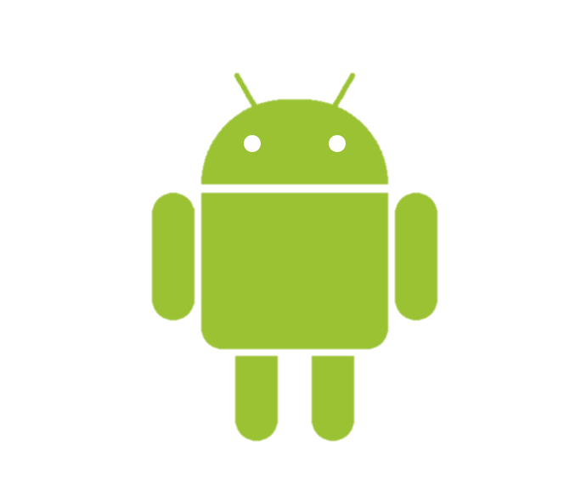



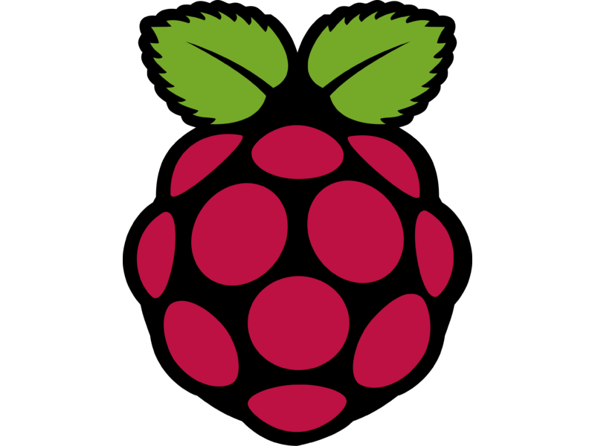
On-device ML
Run your model on the user's device
No need for a server
Supported platforms
Android/iOS
Web
Python
Desktop
Raspberry Pi

Slide 12
Available vision solutions:
Object detection
Image classification
Hand landmark
Hand gesture recognition
Image segmentation
Interactive segmentation
Face detection
Face landmark detection
Pose landmark detection
Image embedding

Slide 13
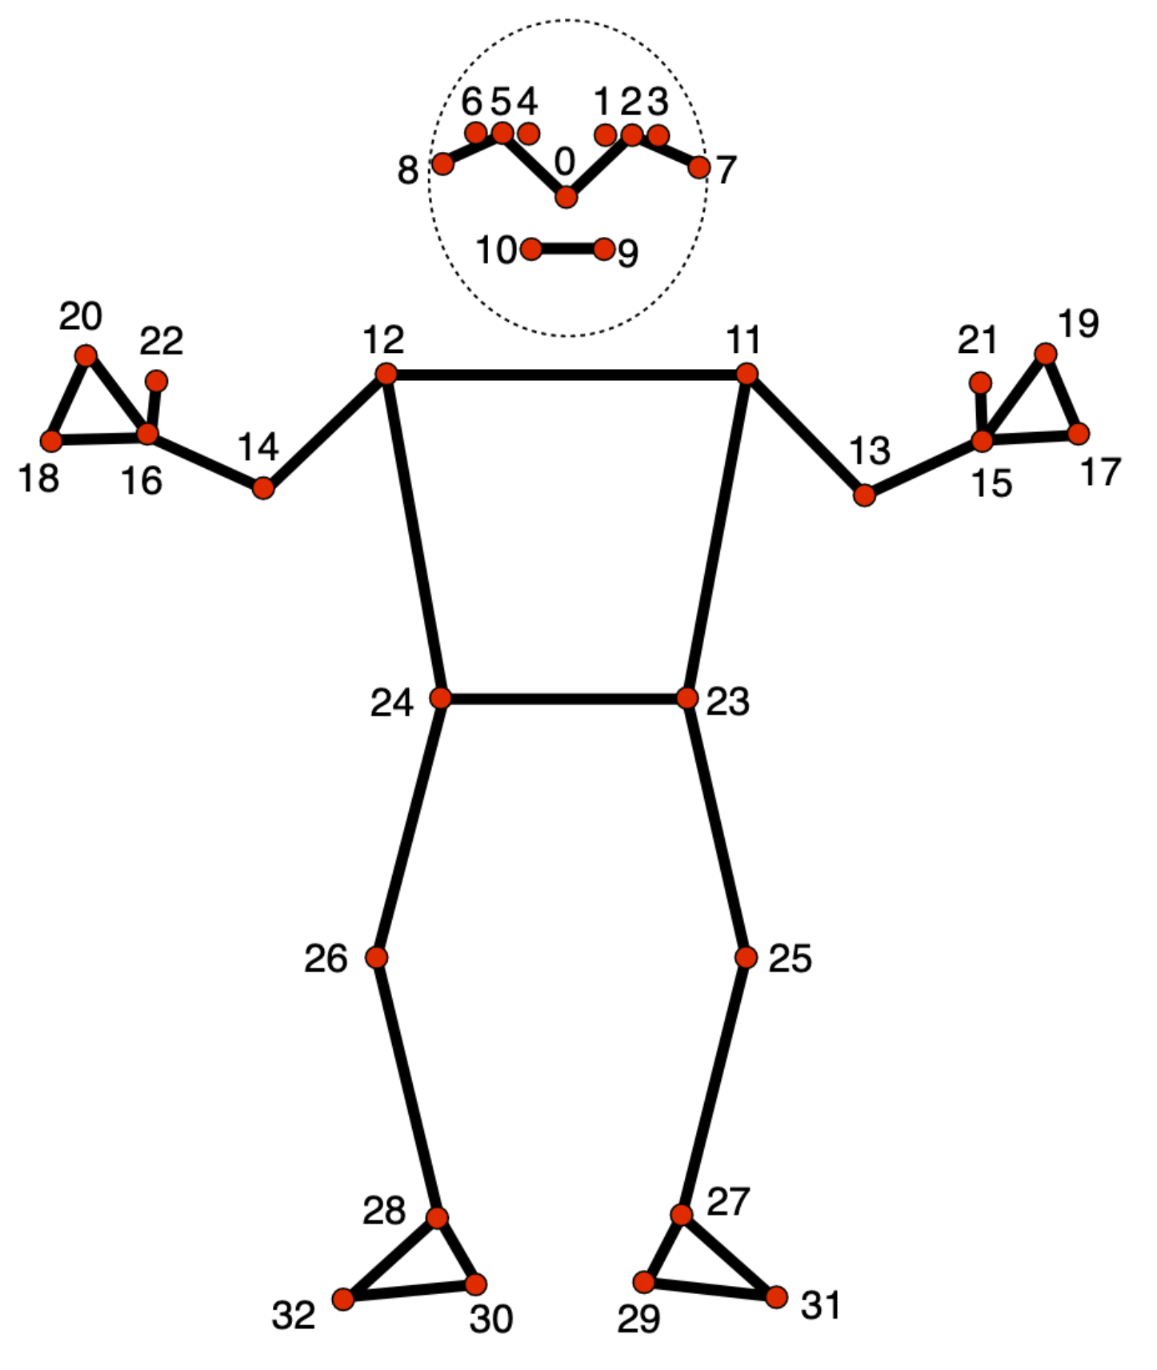
MediaPipe's pose model tracks 33 body landmark locations
Note: The legacy model can detect only one person per image

Slide 14
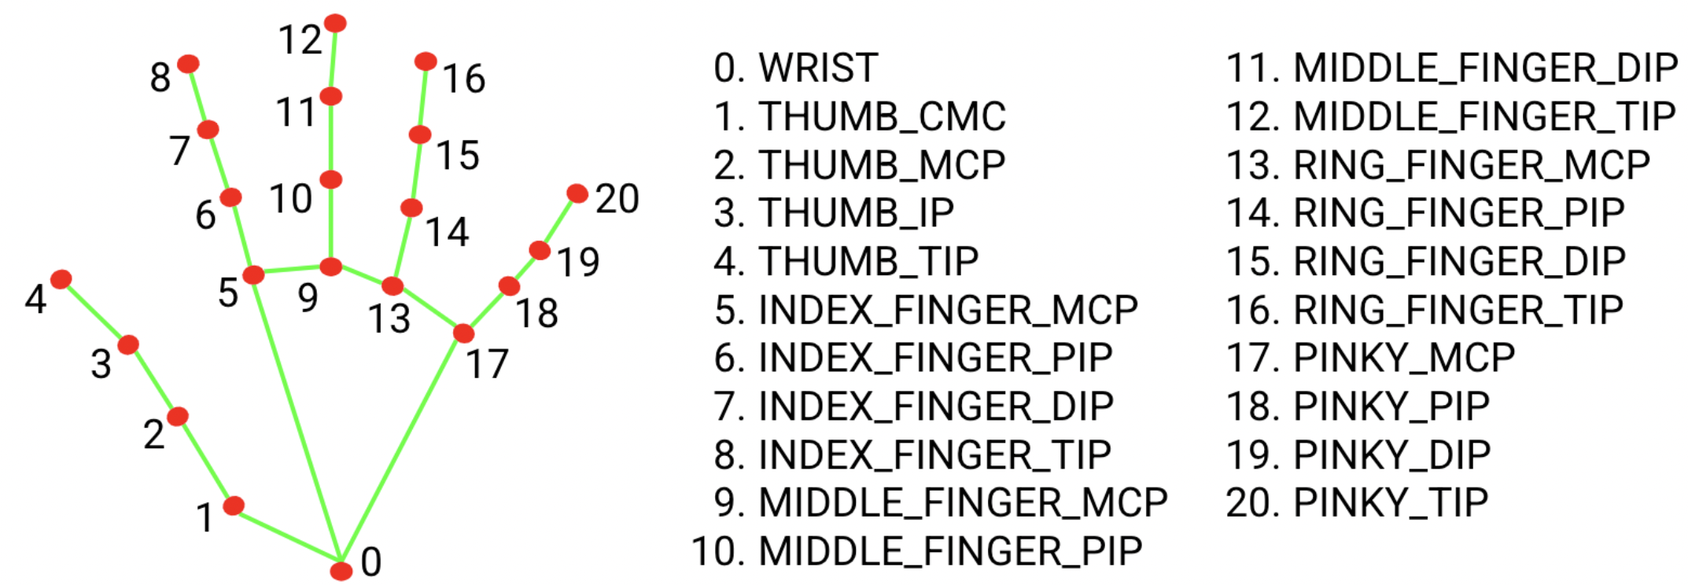
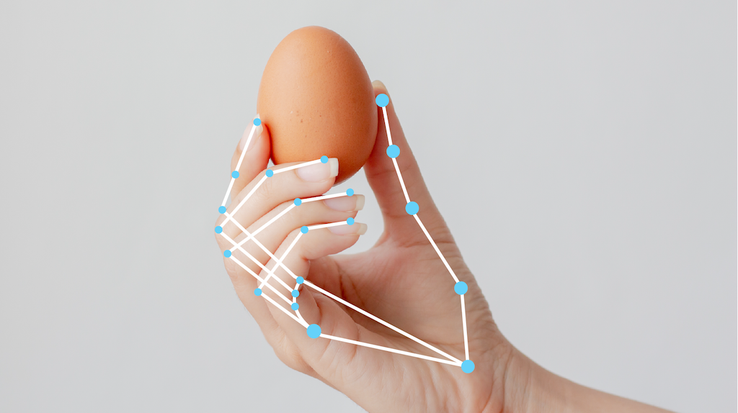
Hand landmark

Slide 15
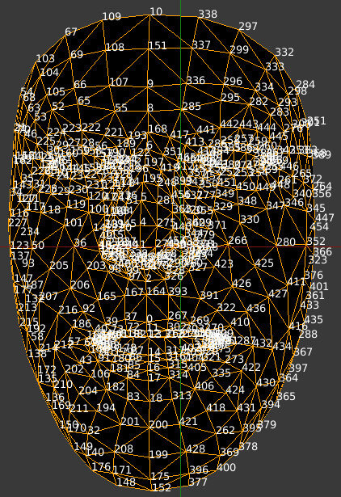
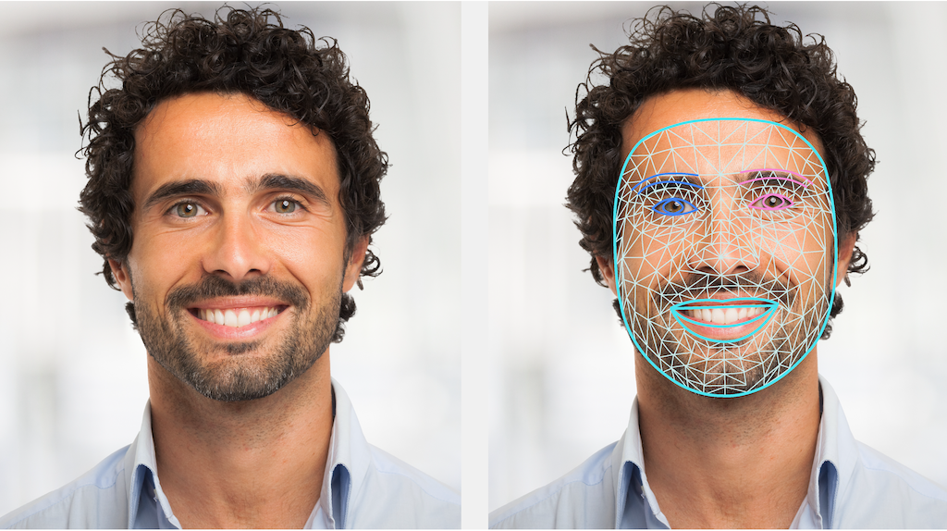
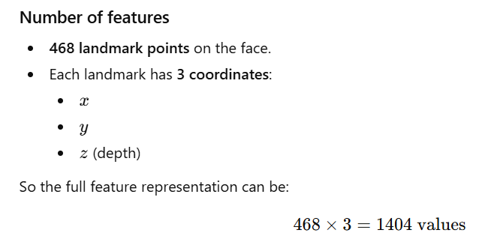
Face landmark detection

